Slide 1
Thanaban co., ltd Business Outline August 2016

Slide 2
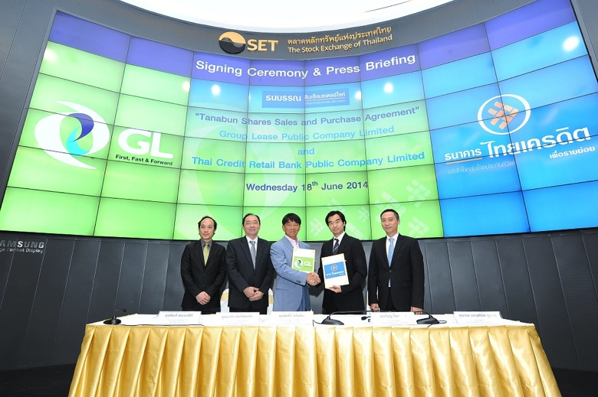

General information of TNB
Company Profile
Thanaban co.ltd
Established in 1978
Head Quarter : Bangkok, Thailand
Representative : Mitsuji Konoshita (Chairman)
Employee: 758 (Total employee in GL Thailand)
On July 3, 2014 became a subsidiary of Group Lease PCL(acquired 100% share),
◆Group Lease PCL (GL)
Established in 1986, GL is a listed financial institution in Stock Exchange of Thailand (SET).
Based on the successful motorcycle finance business in Thailand, GL started business expansion in ASEAN region and new financial products in 2012.

Slide 3

GL Group Companies
Thanaban Co., Ltd
(Thailand)
- Product:
Asset Backed Finance Hire Purchase for 2nd Hand Motorcycle
Group Lease Holding Pte Ltd
(Singapore )
- Product: SME finance
Group Lease Finance PLC
(Cambodia)
- Product: Financial Lease (Motorcycle /Agriculture machine/Solar system)
Group Lease (Lao) Co, Ltd
(Lao PDR)
- Product:
Financial Lease (Motorcycle /Agriculture machine)
PT Group Lease Finance Indonesia
(Indonesia)
- Product:
Financial Lease (Agriculture machine)
Group Lease PCL
(Thailand)
- Product: Hire Purchase for New Motorcycle
Thailand

Slide 4
TNB Products
Motor for cash (MFC)
Asset backed finance service for motorcycle owner
Smart Bike
Hire-Purchase for second hand motorcycle
Car for cash (CFC)
Asset backed finance service for car owner

Slide 5
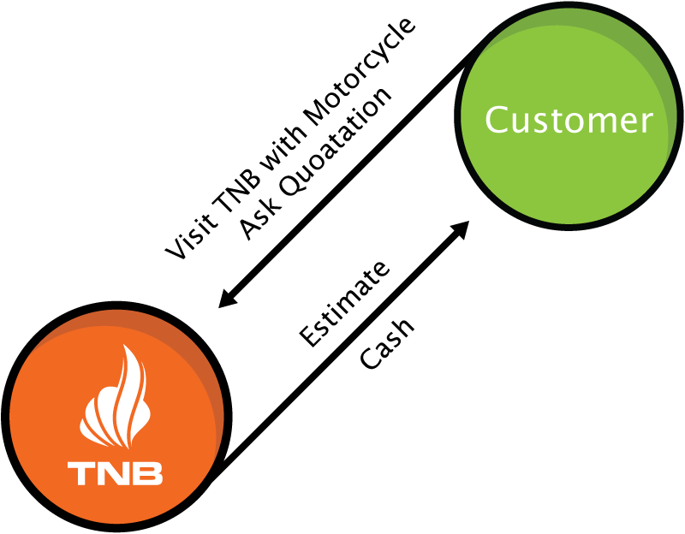
Asset back finance service
Asset backed finance (MFC/CFC)
High finance amount
Accurate evaluation of customer asset from “BUAS” method (Bangkok United Auction System)
Quick & Secure process
15 minutes credit process
Direct credit to customer’ bank account
Easy & Convenient finance
Customer can keep registration
Easy pay off & refinance
Easy payment channel

Slide 6
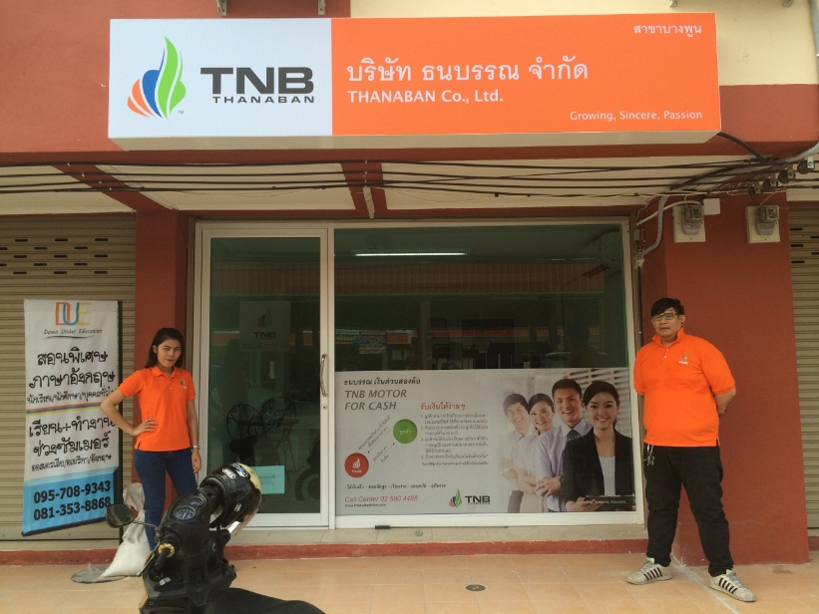
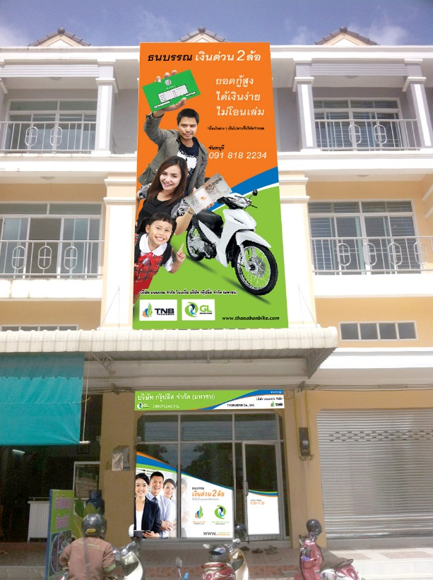
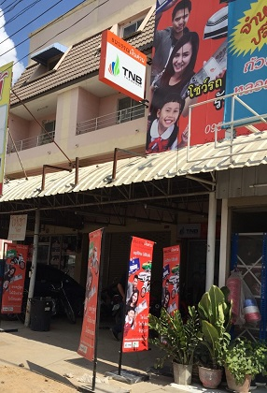
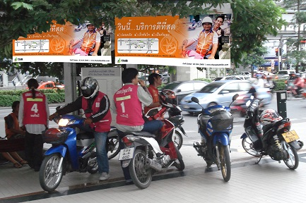
TNB Networks
GL&TNB Branch
GL&TNB Branch

Slide 7

Smart bike (Hire Purchase for 2nd hand)
Other Auction
(Auction) Motorcycle
TNB/GL
Smart Dealer
Cash
(Auction) Motorcycle
Contract
motorcycle
Installment
Down payment
Customer

Slide 8
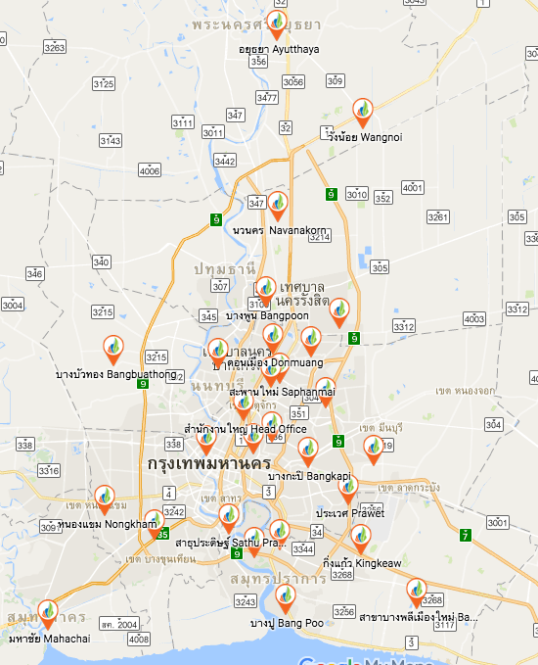
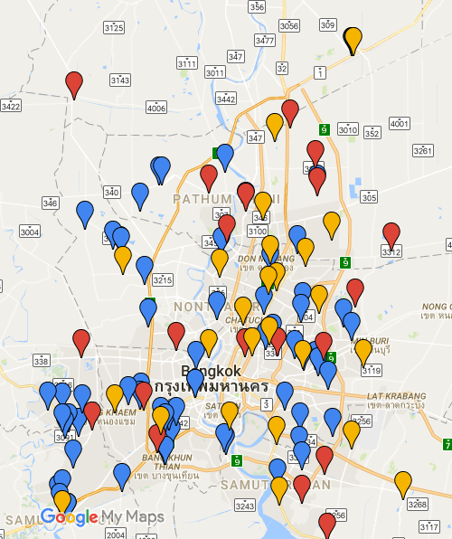
Branch & Dealer Network
TNB developed 40 branches and 150 dealers network in Thailand.
TNB Branch Newwrok in BKK and vicinity
TNB Smartdealer Newwrok in BKK and vicinity

